Slide 1
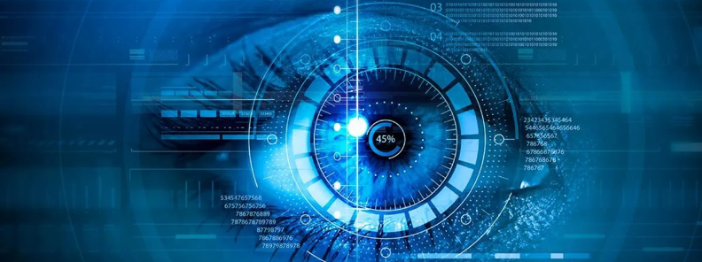
Learning Journey portfolio
Lionel Silva
08/04/2024
ITAI 1378 Computer Vision
Summer 2024 Professor: Patricia McManus | CRN:12461

Slide 2
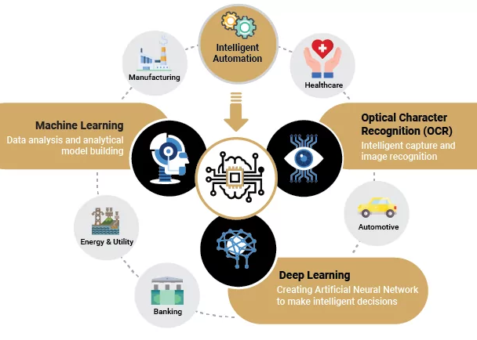
Introduction
The objective of this course is to provide you with the knowledge and skills necessary to achieve your professional goals in computer vision . You will learn the basics of computer vision and its fundamental platforms, as well as the most recent cameras, lidar sensors, high resolution, 3D and stereo vision, and light capture. Furthermore, you will gain an understanding of the algorithms and techniques that enable computers to process images and videos, and how the Machine Learning process aids in the progress of image understanding from in immense set of data.

Slide 3
Module 2 Camera & Sensors
•We learned about the different types of cameras and sensors and their applications.
•Primary computer cameras utilize image sensors and algorithms to capture and explain visual information. Their applications include robotics, automation, and surveillance.
•RGB cameras, being popular computer vision cameras, are widely used in a variety of applications such as object detection, facial recognition, and traffic monitoring.
•Depth cameras create 3D maps of the surroundings by calculating the space among objects in the scene. They are used in gesture recognition, robotics, and augmented reality applications.
•Thermal cameras capture images by detecting the heat emitted by objects and are utilized in applications like firefighting, medical imaging, and surveillance. Stereo cameras utilize two or several cameras to capture 3D images and are employed in applications such as autonomous vehicles and mapping.
LiDAR (Light Detection and Ranging) is a remote sensing technology that utilizes laser pulses to calculate length and make 3-D maps of the surroundings. It is usually in self-driving cars and other robotics applications.
Radar (Radio Detection and Ranging) is a remote sensing technology that utilizes radio waves to reveal and find objects. It prevents collision and changeable cruise control in automotive applications.

Slide 4
Module 5: Machine Learning for computer vision
This module covered the following:
Data Types: Tabular, Image, and Text.
Features and Labels in ML: Structuring Tabular Data for ML Tasks.
Supervised vs. Unsupervised Learning: Concepts and Applications
ML Lifecycle: problem definition, data processing, model Training, and Model evaluation and comparison.
What l learned in this module is the three types of ML :
Supervised learning needs training data with labels. While unsupervised learning does not need labeled data. Moreover, Reinforcement Learning uses a trial-and- error method to learn.
Activities: L05 Image Classification with Nearest Neighbors.

Slide 5
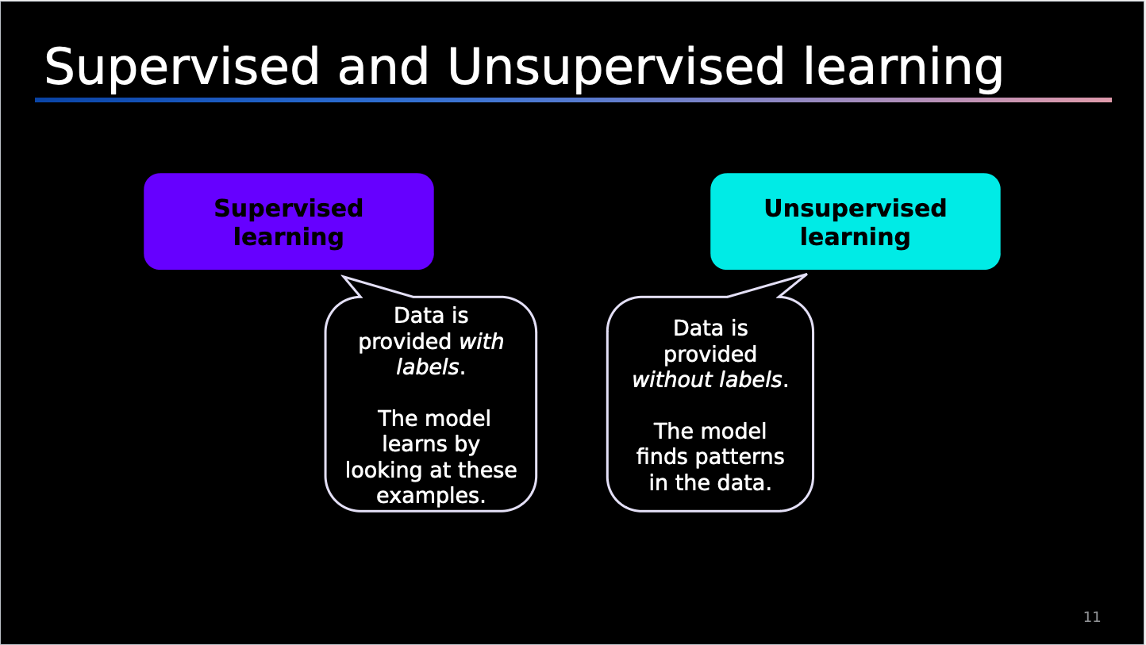
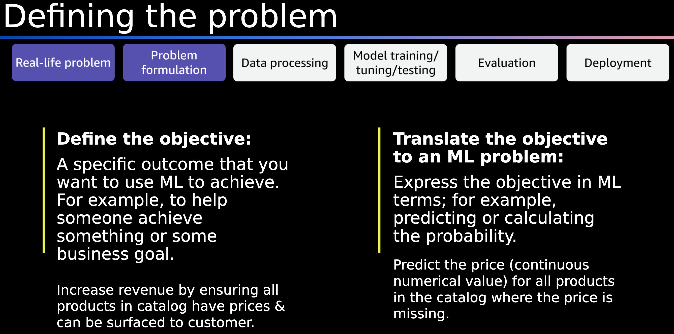
Module 5: Machine Learning for computer vision

Slide 6
Module 6: Basics of Neural Network
This module covered the following:
Artificial Neuron
Machine Learning basics
Neural Network components
Training Neural Networks
Training Neural Networks
Neural Network Architectures
•A neural network is a computational model stimulated by the form and role of the human brain.
I learned about the training process initialization, feedforward, loss calculation, backpropagation, weight update, iteration, and evaluation. In addition, I learned the architecture of neural networks. There were single-neuron output and multi-neuron output. In a single-neuron output, regression or binary classification is made. In contrast, the multi-neuron output makes multiclass classification.

Slide 7
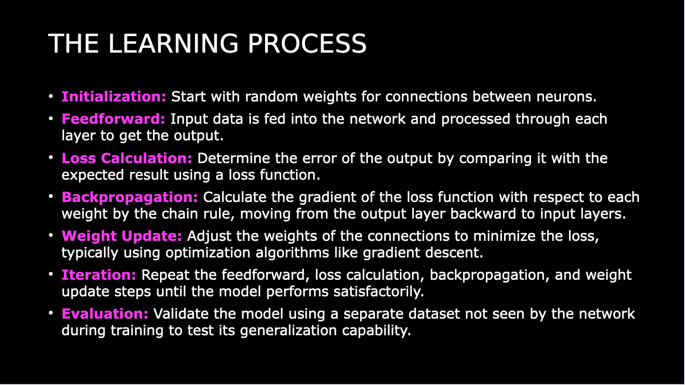
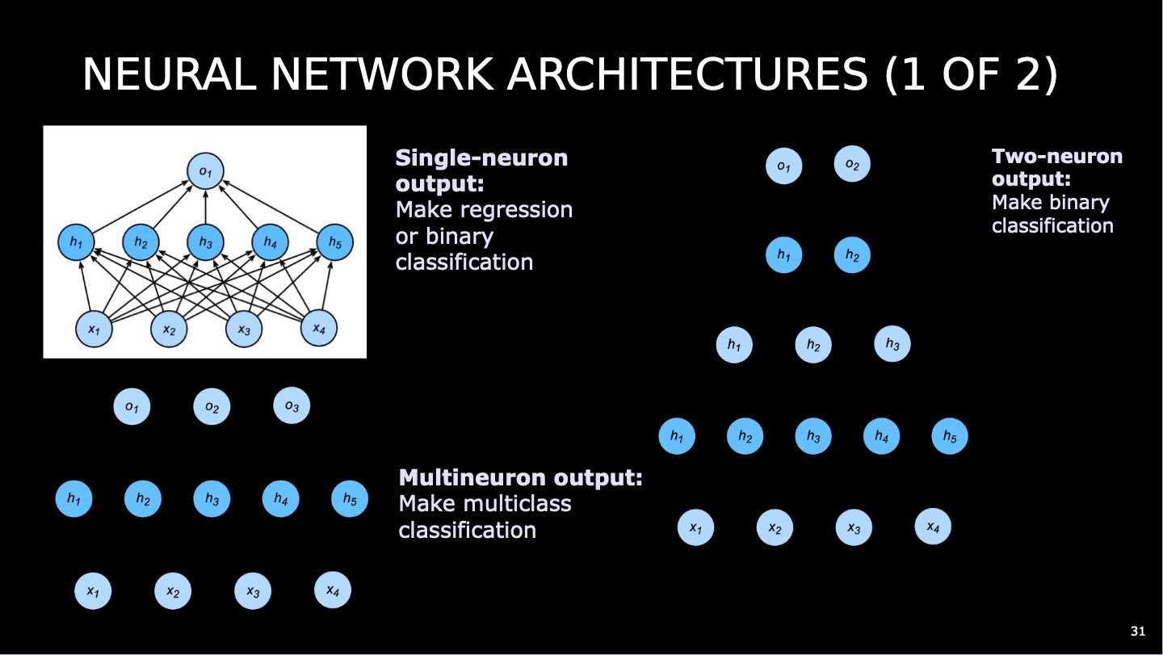

Slide 8
Module 6: Basics of Neural Network
Assignments:
A06 –TensorFlow Playground
Lab 06 Chihuahua or Muffin ?
In A06 I gained understanding on how parameters affect the performance of the networks. In the lab 06, we learned how to import data to classify, distinguish, and identify images. We attained knowledge on how to develop a deep neural network model using the Chihuahua or muffin. By using datasets to train, test, and validate, we were able to understand how deep learning and neural networks work in conjunction.
Challenges encountered:
I had a few challenges with this assignment. To start with, I had to learn how to use AWS SageMaker Studio Lab. I overcome this challenge by watching a YouTube video tutorial for beginners. This made it easy to navigate the studio and complete my lab.
Potential real-world applications:
This model is useful in real-world applications where objects must have to identified certain features for quality control. For example, this model can be used in manufacturing to detect defect parts. As well to detect a good part. This model is useful in real world applications to validate only good parts. This model helps manufacturing plants to meet their quality standards.
My reflection on this lab is to be knowledgeable in deep learning and neural networks, you must understand what each code dataset you are imputing means.

Slide 9
L06
A06
L06

Slide 10
Module : 7 Convolutional Neural Networks
This module covered the following:
Introduction to Convolutional Neural Networks.
Core components of CNNs and how they process images.
CNN training and leveraging libraries
Applications, challenges, and future research.
Computer Vision datasets.
•A convolutional neural network (CNN) is a deep learning algorithm that extracts features and identifies patterns. CNNs outperform traditional methods at comprehending spatial structure in images.
I learned about the training CNNs, libraries, applications, challenges, future research, core components and cv datasets. The core concepts included:
•Convolutional layers feature extraction.
•Pooling layers minimize dimensionality.
•Fully connected layers classification.

Slide 11
Module 7: Convolutional Neural Networks
•Assignments:
•A07 –ITAI 1378 Manual CNN
•L07 Chihuahua or Muffin with CNN
•In A07, I gained an understanding of the task of Convolutional layers and filters in image processing. In the L07, I learned that CNN, when it extracts significant features from images, does it with enhanced precision.
Challenges encountered:
The challenges I faced were when I had to fix the errors in the program's cells. I encountered errors in the program that I could not solve, but going through the program was still a rewarding experience. I gained a solid understanding of the code in the program, and I am confident in my ability to become an expert programmer.
My reflection on this lab is it provides a solid understanding of why CNN outperforms traditional neural networks. Additionally, it explored ethical concerns in areas like deep fake creation, invasion of privacy, and image manipulation.

Slide 12
L07
L07
L07

Slide 13
Module : 8 CNN Basic Architecture And Transfer Learning
This module covered the following:
•Convolutional Neural Networks (CNNs) Recap •Basic concepts and applications •Image datasets •Transfer Learning •Concept and motivation •Approaches and techniques •Pre-trained models and toolkits •Basic CNN Architectures •Historical perspective •Key innovations •Deep dive into: •LeNet •AlexNet
I learned about the importance of transfer learning, which includes time/resource efficiency and performance. I also learned how CNN architecture has evolved over time. Lastly, I gained knowledge on AlexNet, which is used to artificially enlarge training datasets.

Slide 14
Module : 8 CNN Basic Architecture And Transfer Learning
Assignments:
A08 –ITAI 1378 Manual cv
In A08 we learned about the key concepts, which include bounding boxes, annotations, IoU, and confidence score. A Bounding box is a virtual box encompassing an object in an image. Annotations are the format used to label images given to a dataset. The confidence score indicates the possibility of an object being present in the bounding box. In addition, we also cover the algorithms like R-CNN, Faster-R-CNN, Fast R-CNN, and SSD. These algorithms play a crucial role in object detection for example Faster-R-CNN evaluates a region-based object classification (ROI) by using the feature maps given through the convolutional layer. In SSD the algorithm executes real-time detection in numerous objects in an image with high precision. R-CNN uses a discriminating search technique to identify Rols in the input images.
Challenges encountered:
No challenges for this assignment.
My reflection on this assignment:
This cheat sheet will benefit us in the future when performing object detection tasks because we have gained enough knowledge of the steps to take when starting one. We have also gained knowledge of the fundamentals of key concepts, common challenges and solutions, and the libraries and tools needed for the task.

Slide 15
A08
A08
A08

Slide 16
Module : 09 Advanced CNN Architecture And Object Detection & Recognition
This module covered the following:
•Basic CNN architectures • Transfer Learning Advanced CNN Architectures Object Detection • Bounding Boxes • Two stage detection • One stage detection
I learned about the differences between one-stage and two-stage detectors. In one-stage detectors, speed is prioritized, and in two-stage detectors, accuracy is prioritized. I also learned that bounding boxes are important for determining an object's location.

Slide 17
Module : 09 Advanced CNN Architecture And Object Detection & Recognition
Assignments:
L09 Object detection using Transfer learning and Pascal VOC 207 Dataset
Object detection challenge
Challenges encountered:
The Pascal VOC dataset had incorrect labeling. CIFAR-10 images were constantly out of focus, and COCO caused timeouts. In contrast, the Oxford –IIIT dataset proved to be the most effective dataset for our needs. The images were clear, labeled properly, and processed efficiently.
Reflection on these assignments:
This experience testing different kinds of datasets will help you pick the one that is appropriate for your application.

Slide 18
Object Detection Challenge
L09
L09

